Slide 1
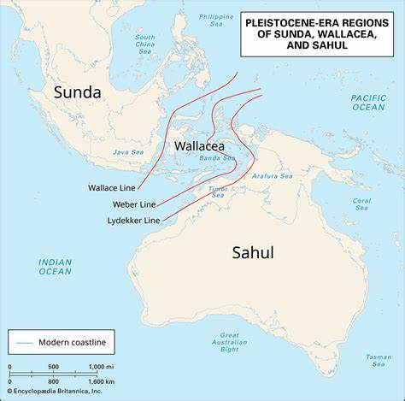
Dispersal into Sahul
Encyclopædia Britannica, Inc.
Pedro, N. et al. (2020) ‘Papuan mitochondrial genomes and the settlement of Sahul’, Journal of Human Genetics, 65(10), pp. 875–887. doi:10.1038/s10038-020-0781-3.
The first modern humans to arrive in Sahul would have had to island hop across the Wallacea line with some of the leaps being up to 90km long.
Context: Sahul was a landmass that included Australia and Papua New Guinea. It was separated from Southern Asia by the Wallacea line which to this day results in a huge difference in biota between South Asia and Oceana.
The expansion of humans from Africa to Sahul would have been rapid. The results of the analysis of mtDNA samples from modern indigenous Papuans showed that they are the closest living relatives of the initial group dispersing from Africa. This is results from the rapid dispersal rate but also from isolation of the region after the rise of sea levels around 8kya. It was thought that there were two main dispersals based on two lineages of maternal DNA in north and south Sahul neither of which were derived from each other.
Genomic data suggests that Australians and Papuans diverged from Eurasians around 50kya which would also signify the arrival of people in Sahul. It is thought that an initial group of 1300-1550 individuals underwent the crossing which would indicate a planned event given the context surrounding the journey.
Encyclopaedia Britannica, Inc

